Slide 1
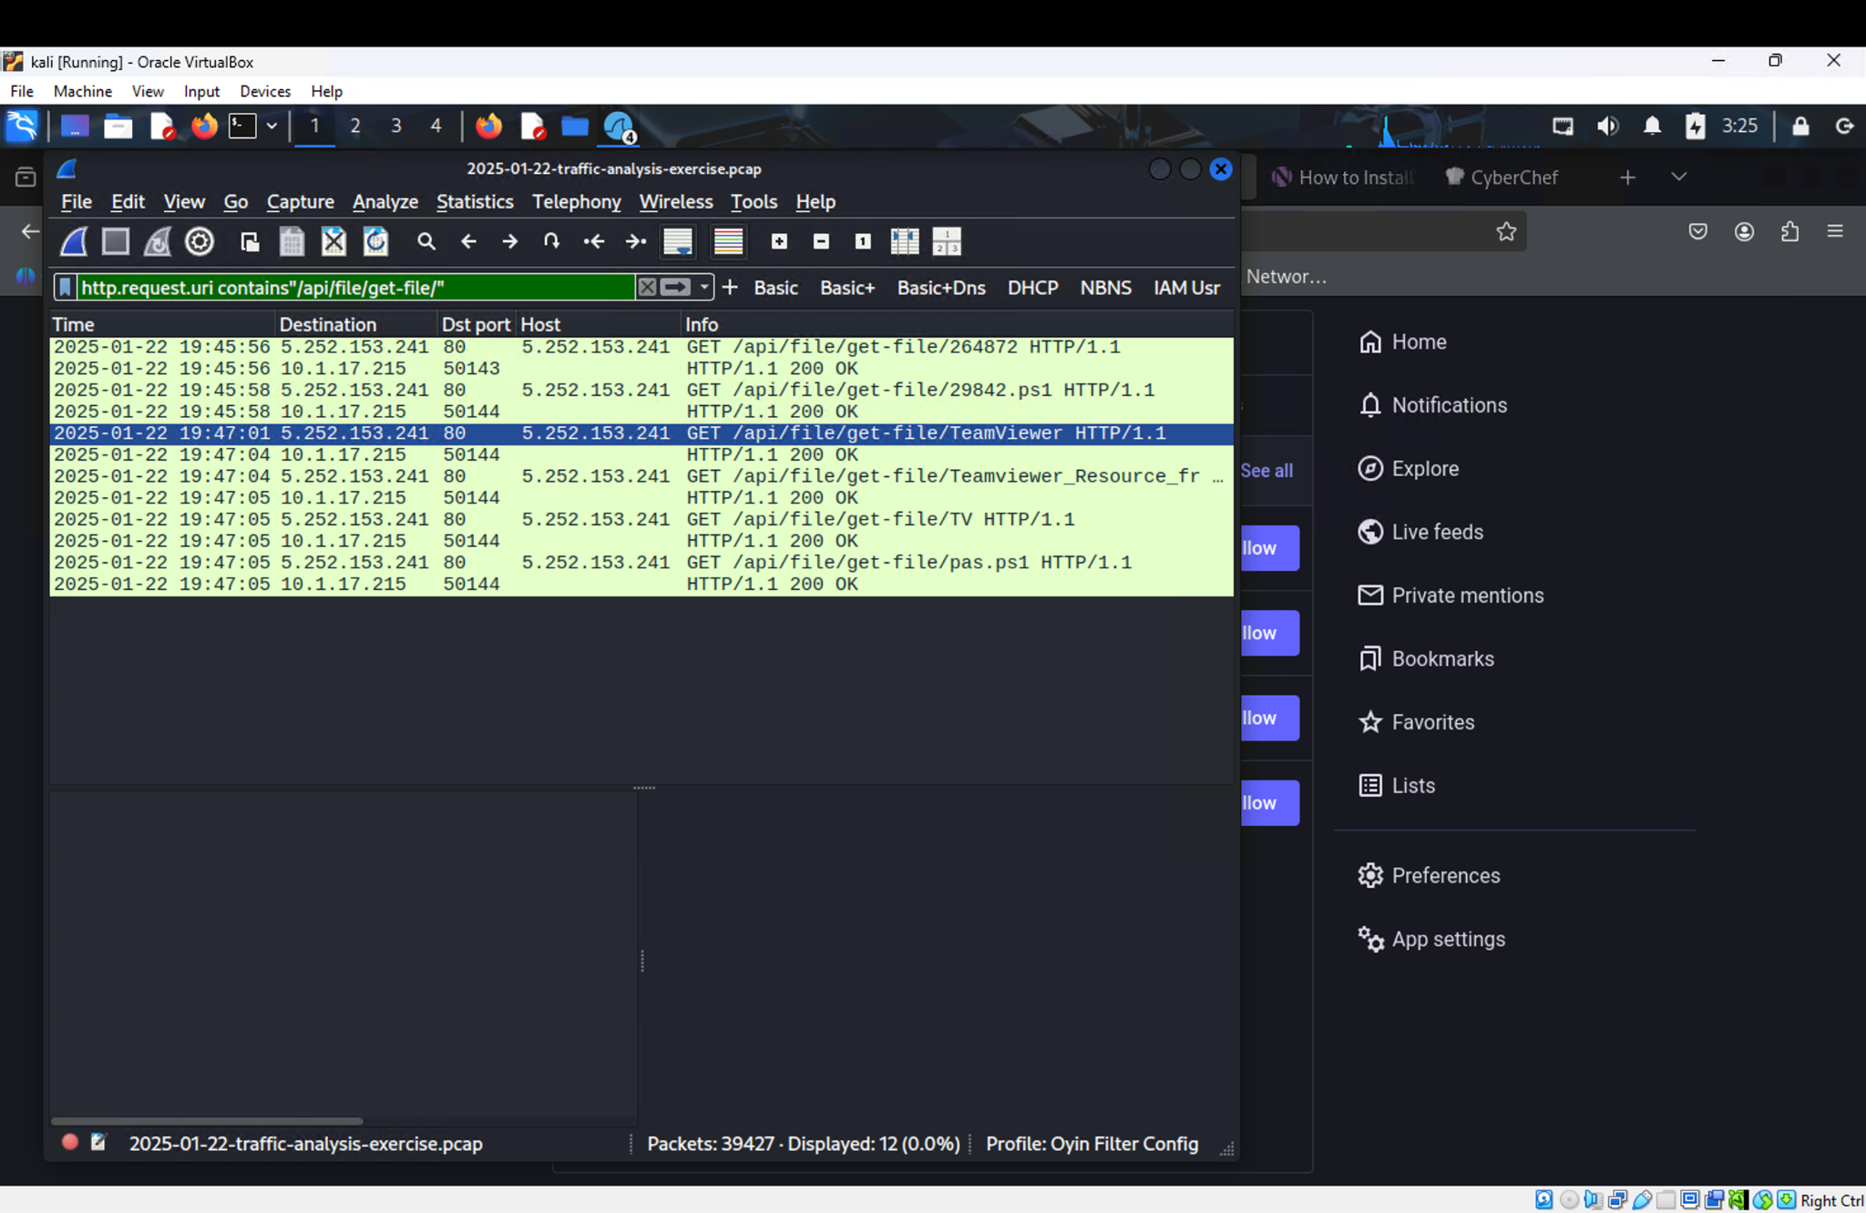
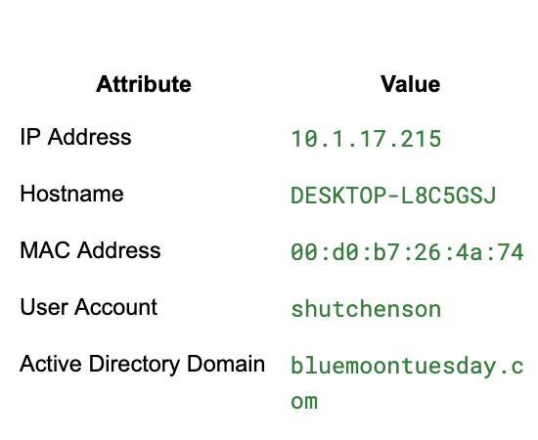
Title: Malware Infection Summary
(Emotet-style Loader Activity)
Contents:

Slide 2
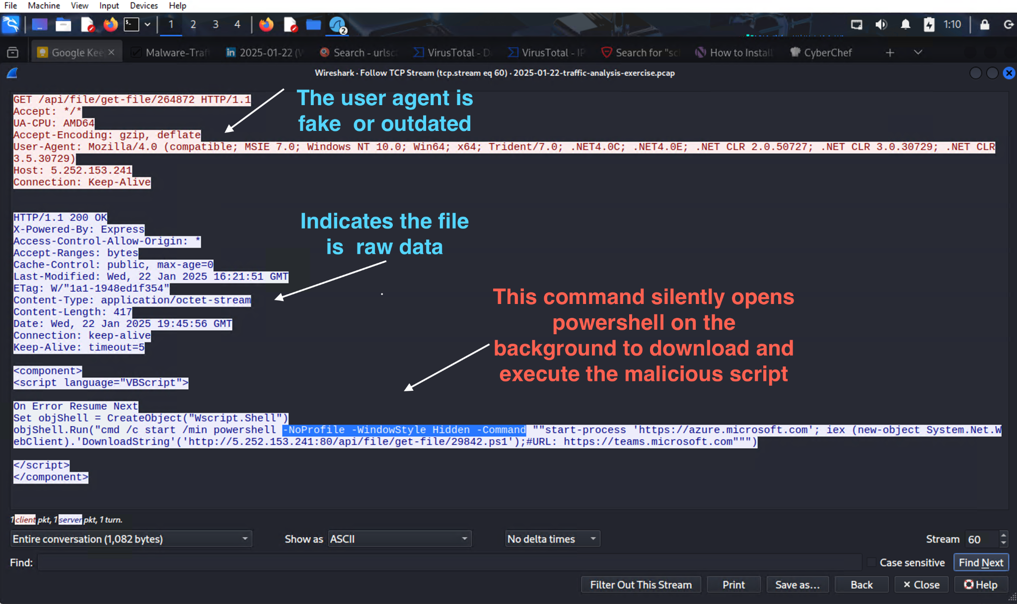
Malicious Payload and Persistence
Delivered script contains:
objShell.Run → executes hidden PowerShell
Downloads multiple files (TeamViewer.exe, DLLs, .ps1)
Creates a shortcut in Startup folder
Persistence achieved via:
%APPDATA%\Startup\TeamViewer.lnk
Files stored in C:\ProgramData\huo

Slide 3
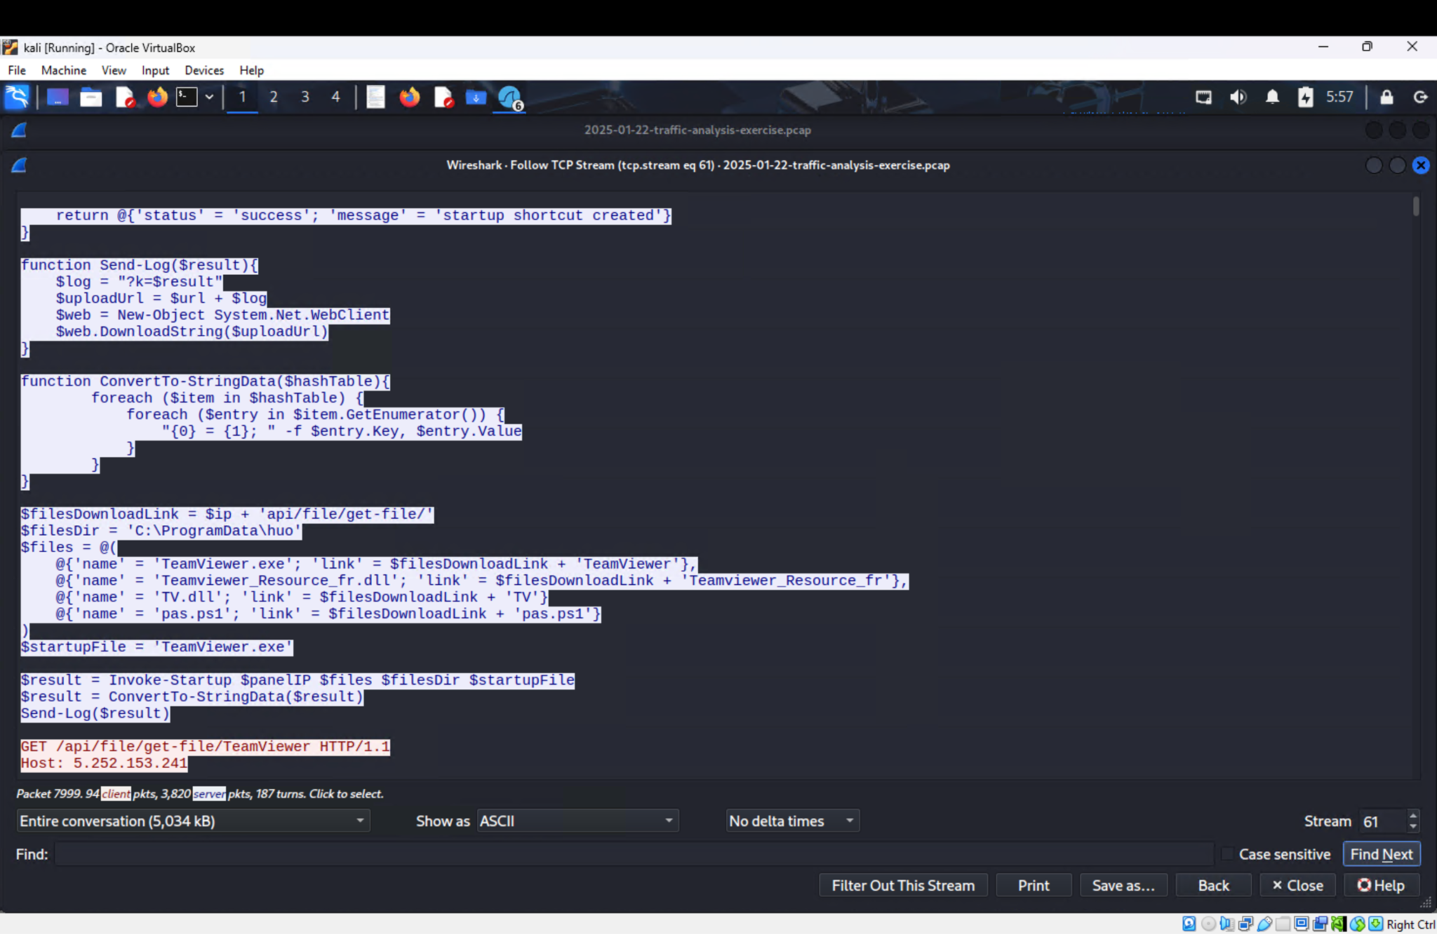
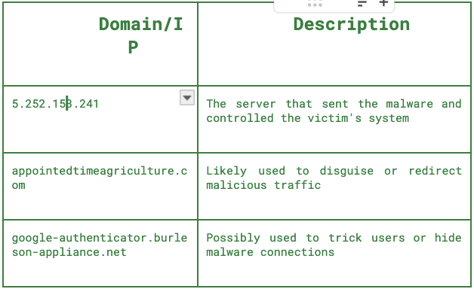
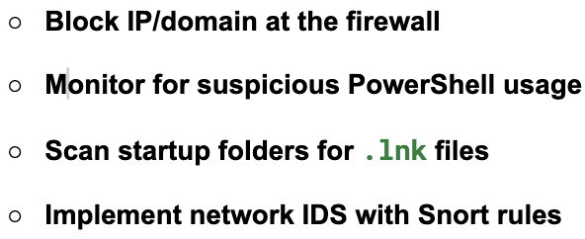
Indicators of Compromise (IOCs) & Mitigation
Victim → Malicious IP: 5.252.153.241
Initial request: GET/api/file/get-file/264872
Payload delivered : VBScript that runs PowerShell
Mimics: Microsoft Teams,Azure,TeamViewer
Recommendations:

